Slide 1
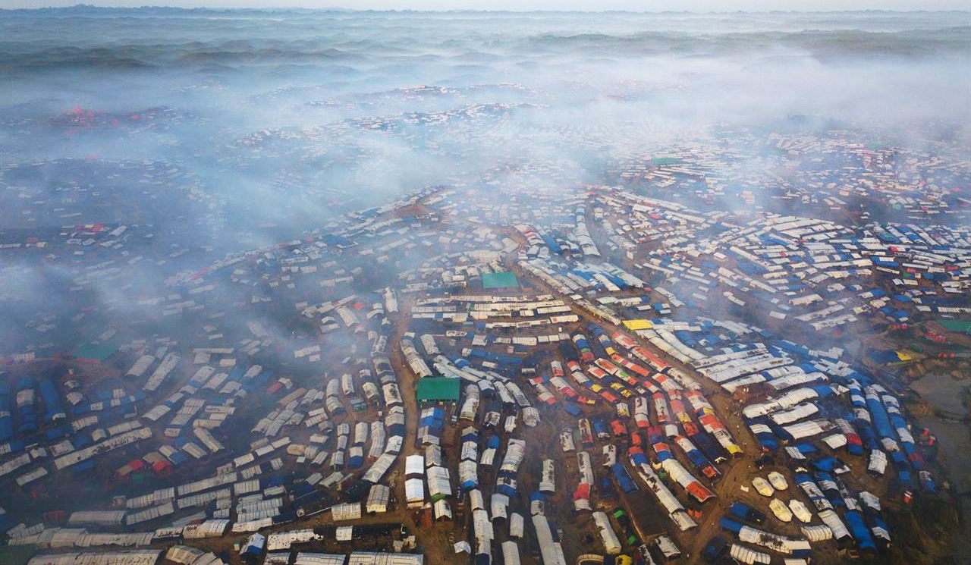
Cox’s Bazar Bangladesh:
Managing COVID19 risks in camp settlements
- A collective effort for protection of over 850,000+ camp residents -

Slide 2
Bangladesh Preparedness and Response Planning for Covid-19
Case Detection and Status in Bangladesh
8 March 2020: The first 3 cases in Bangladesh were confirmed by Institute of Epidemiology, Disease Control and Research (IEDCR)
11 March 2020: WHO declares COVID-19 is a global pandemic
218 confirmed cases
20 deaths
Source: IEDCR as of 08th April 2020
Cox’s Bazar Preparedness and Response Plan Development Process
Joint Government & ISCG Preparedness and Response Plan for Covid19
For Cox’s Bazar District
Joint Government & ISCG Preparedness and Response Plan for Covid19
For Camp Settlements

Slide 3
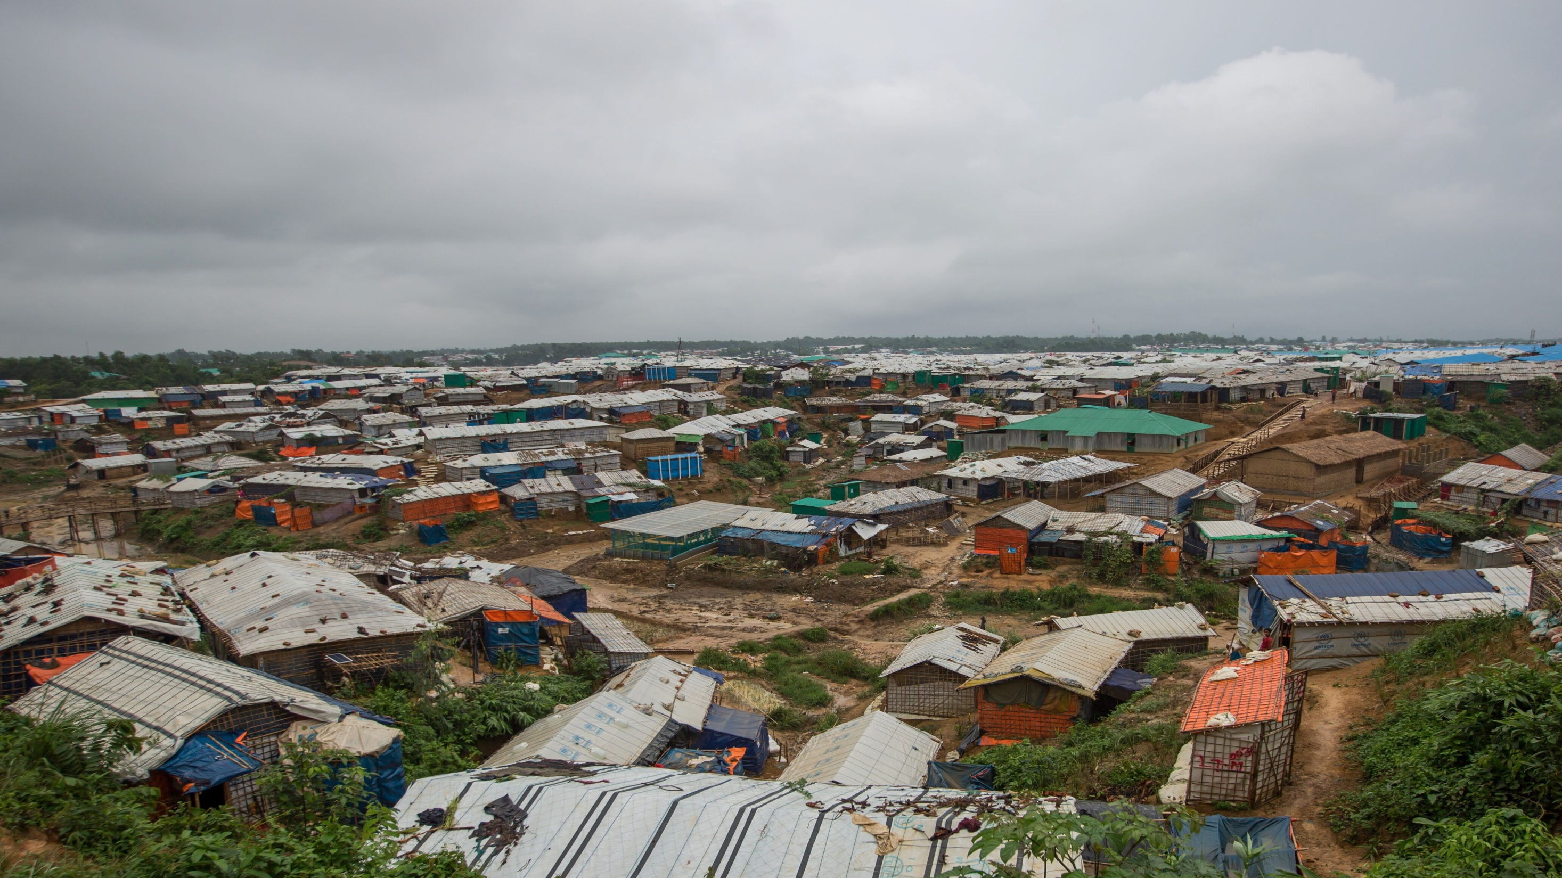
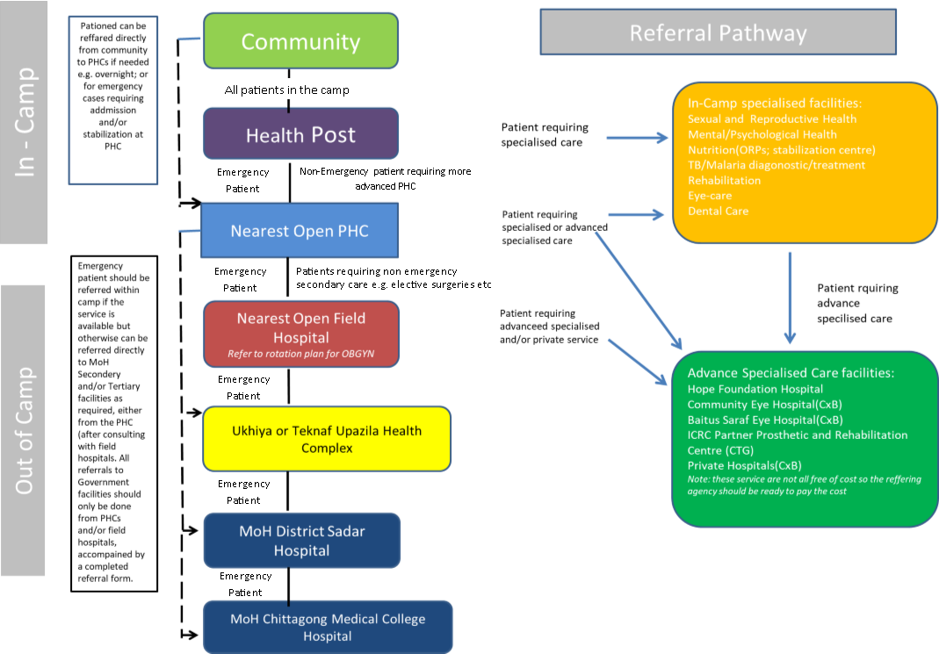
Cox’s Bazar Preparedness and Response Update
Health Referral Pathway
Set up of coordination mechanisms by GoB and ISCG Health Sector
Continuation of essential services following safety protocols and approved by Refugee Repatriation and Relief Commissioner (RRRC) office
Community awareness and engagement across all 34 camp settlements through CwC engagement
Increase in health monitoring and awareness activities in all camps through health sector
Increase in water sanitation and hygiene promotion activities in all camps through WASH sector
Set up of health referral pathway with Government authorities
Enhancement of health facility capacities across all camps
Addition of suspected case isolation facilities within the camp settlement
Set up and enhancement of Covid19 testing capacity in Cox’s Bazar
Enhancement of health facilities at sub-district level and district level for treatment including ICU facilities
Procurement of essential items including PPE, disinfection items, equipment

Slide 4
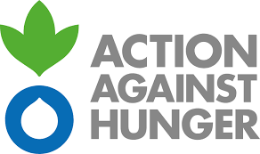
Working together for collective action to engage on Covid19 in Cox’s Bazar
… and many others

